Slide 1


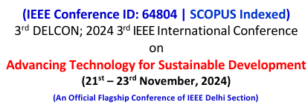
IEEE Conf. I’d - 931
Analyzing Sequential Patterns in Customer Supermarket Transactions
Authors: Shashwat Sharma, Ritik Roshan, Yatharth Aggarwal, Dr. Mala Saraswat
Affiliation: Bennett University, Greater Noida, India (School of Computer Science Engineering & Technology)

Slide 2
Contents
Introduction
Problem Statement
Literature Survey
Research Objective
Experiment Conducted
Methodology
Results & Discussion
Future Scope
References

Slide 3
INTRODUCTION
In today's digital world the products from supermarket have gained a high amount of data, through which we can understand the high utility usage of sequence pattern mining to extract meaningful insights from supermarket sales data.
By examining the methodologies, experiments and insights gained from analyzing the patterns of the project we will unveil understand the supermarket sales data through high utility sequence patterns.

Slide 4
PROBLEM STATEMENT
Understanding Customer Behavior – Identifying recurring patterns in purchase sequences.
Optimizing Business Strategies – Leveraging insights to improve product placement and promotions.
Uncovering Hidden Relationships – Exploring connections between different product categories and purchasing habits.

Slide 5
LITERATURE REVIEW(Recent)
Title | Methodology | RESULTS
Existing Sequence Mining Techniques | Review of traditional methods, limitations, and potential improvements | Using Classification system, got the total no. of target variable of distinct values in variance is approx 61
High Utility Pattern Mining Approaches | Exploring algorithms specialized in identifying high-value sequences | Using FP Growth and comparative analysis we get the accuracy :- Apriori – 0.002 (approx) and FP Growth – 0.003
Applications in Retail Analytics | Analyzing case studies and industry-specific challenges in supermarket data | Accuracy of P value – 2.42 And T- Statistic : -8.91

Slide 6
DATASET UTILIZED
The dataset for this research was sourced from Kaggle, containing transactional data from supermarkets.
Key Attributes: Includes Transaction ID, Product ID, and Timestamp for sequential pattern analysis.
Preprocessing Steps: Removed duplicates.
Handled missing values.
Converted data into a basket format for analysis.
Significance: Provides real-world insights into customer purchasing behavior and frequent product combinations.
Role in Research: Forms the foundation for applying the Apriori algorithm and generating actionable marketing strategies.

Slide 7
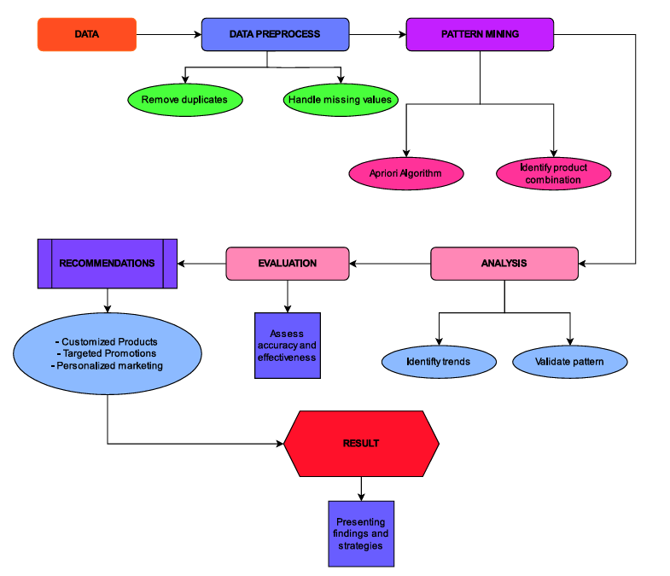
PROPOSED METHODOLOGY
Data Collection: Gather transaction data (Transaction ID, Product ID, Time) from major retailers for initial analysis.
Data Preprocessing: Clean the data by removing duplicates, handling missing values, and formatting for pattern mining.
Pattern Mining & Analysis: Use the Apriori Algorithm to discover product combinations, followed by trend validation through analysis.
Recommendations & Result: Create customized marketing strategies, document findings, and present validated insights and strategies to supermarkets.
Fig.2 Overall pipeline followed in methodology

Slide 8
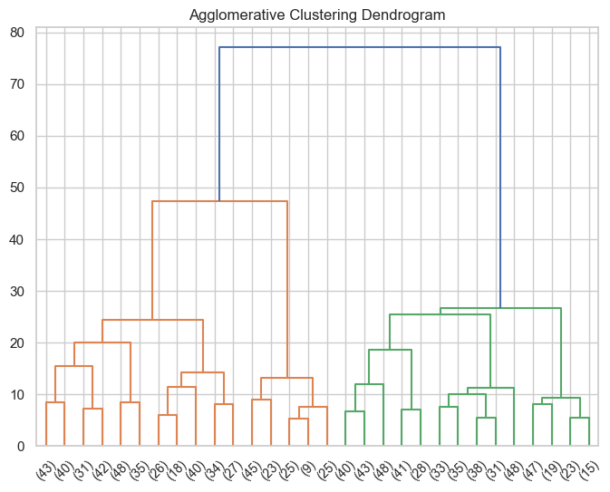
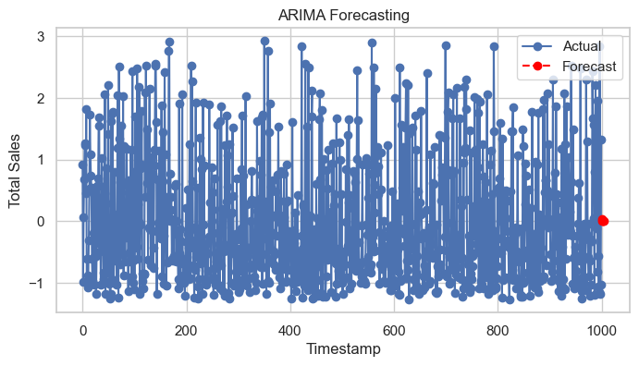
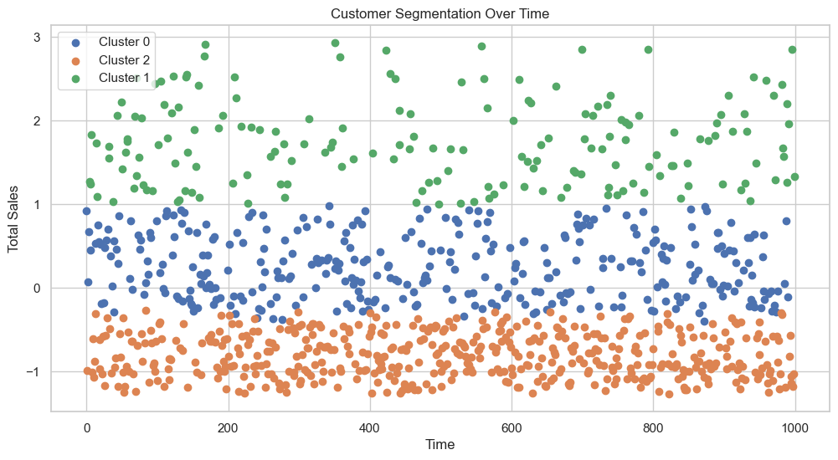
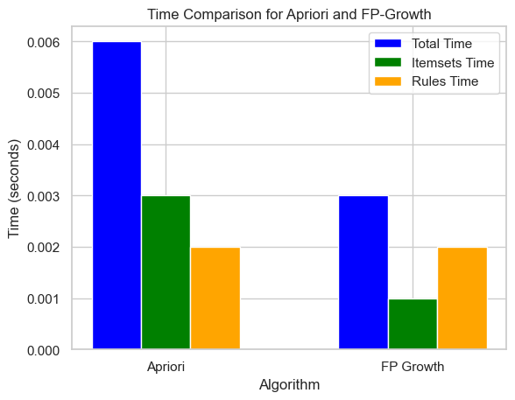
EXPERIMENTS CONDUCTED
Fig 1. shows the results of aggregative hierarchical clustering applied to the retail store dataset.
Fig 2. shows the results of predicting total sales using the Autoregressive Integrated Moving Average (ARIMA) model in the context of our research examining a continuous sample of users.
Fig 3. shows the distribution of consumers according to their purchasing behaviour during the period, within the scope of our research examining consumer behaviour in the retail market according to standards.
Fig 4. shows the execution time comparison between Apriori and FP-Growth algorithms in the context of our research examining the connectivity pattern in a large consumer market.
Fig. 2 ARIMA Forecasting of Total Sales
Fig. 1 Agglomerative Hierarchical Clustering Dendrogram
Fig. 3 Customer Segmentation Over Time
Fig. 4 Time Comparison for Apriori and FP-Growth

Slide 9
RESULTS
In table 1 the efficiency of the Apriori and FP-Growth algorithms by comparing their total execution times, along with the time spent on object creation and rule generation. It provides insights into the computational efficiency of each algorithm for pattern mining.
In table 2 the summarization different customer segments based on their average spending, transaction frequency, and predominant product choices. It offers a clearer understanding of customer behaviors and preferences, which can guide targeted marketing strategies.
Algorithm | Total execution time (s) | Time spent on object creation(s) | Time spent on rule generation(s)
Apriori | 12.4 | 8.2 | 4.2
FP Growth | 8.6 | 4.7 | 3.9
Table 1. Execution Time Comparison
In table 3 The accuracy metrics (RMSE, MAE, and MAPE) for the ARIMA model, demonstrating its effectiveness in forecasting future sales trends based on past transaction data. These metrics help in evaluating the model's reliability for predicting sales
Overall, our research enables supermarkets and retailers to improve their marketing strategies, operational processes and customer satisfaction.
Segment | Mean Spending ($) | Number of Transactions | Predominant products
Segment 1 | 25.4 | 120 | Snacks
Segment 2 | 75.2 | 85 | Beverages
Segment 3 | 15.3 | 200 | Fresh Produce
Segment 4 | 45.0 | 95 | Dairy
Table 2. Customer Segment Analysis
S no. | Metric | Value
1 | RMSE | 3.56
2 | MAE | 2.14
3 | MAPE | 4.2
Table 3. ARIMA Forecast Accuracy Metrics

Slide 10
Future Scope
The potential for future research identifying connectivity patterns in the consumer marketplace offers many ways to understand and use retail.
The future of pattern analysis in the consumer market contains many opportunities, including professional data mining, integration of external information, instant recommendations, forecasting needs for prediction, and ethical decision-making.
By examining these factors, researchers and professionals can understand our understanding of the retail market as a trend and create opportunities to improve merchandising, customer engagement, and marketing

Slide 11
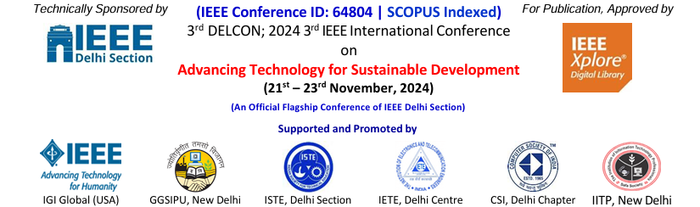
Thank You
Authors: Shashwat Sharma, Ritik Roshan, Yatharth Aggarwal, Dr. Mala Saraswat
Affiliation: Bennett University, Greater Noida, India (School of Computer Science Engineering & Technology)

